Slide 1
Recognition of Handwritten Mathematical Expression
Ankan Mookherjee
Supervisor: Dr. Richard Zanibbi

Slide 2
Preprocessing
- Normalize expressions to [0,200] in Y dimension,
preserving aspect ratio.
- Smooth strokes
- For segmentation, normalize each stroke to 30
points.
- For classification, normalize each symbol to 30
points
- PCA on segmentation features

Slide 3
Segmentation
Heavily based on [1]
Simple AdaBoost classifier (50 decision stumps)
- Step through each stroke in expression
- Classifier says ‘MERGE’ or ‘SPLIT’
[1] Lei Hu;; Zanibbi, R., "Segmenting Handwritten Math Symbols Using AdaBoost and Multi-­scale
Shape Context Features," Document Analysis and Recognition (ICDAR), 2013 12th International
Conference on , vol., no., pp.1180,1184, 25-­28 Aug. 2013
doi: 10.1109/ICDAR.2013.239

Slide 4
Segmentation Features
- 3 shape context features (stroke-pair, local, global), 60 bins each
- Current stroke features
- E.g., Number of points, distance between first and last point
- Stroke pair features (Previous + Current & Current + Next)
- Bounding box center distance, overlap, ratios
- Minimum and Maximum distance between strokes
- Writing slope (angle between last point of first stroke and first point of
second stroke)
- 206 total features - PCA to 100

Slide 5
Classification
Random Forest classifier
- 100 Trees
- 15 maximum depth

Slide 6
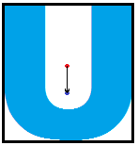
Classification Features
- Shape context feature of whole symbol
- Internal angle (abs(cos), angle from horizontal)
- Number of strokes, cusps, intersections
- Number of points before normalization
- Vector from bounding box center to
average center (normalized)

Slide 7
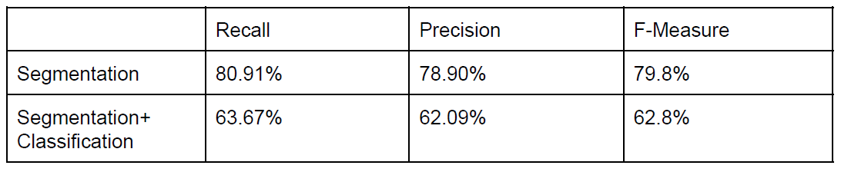
Results
Best Fold:
- Recall and Precision consistently close
- Classification rate: ~78%

Slide 8
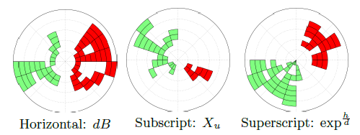
Parsing
Notes:
Tuned parameter chosen in the paper and we will follow that.
number of circles n = 15
Number of angles m = 20 and principal components d = 35

Slide 9
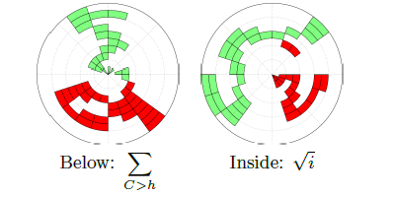

Slide 10
Polar Histogram
-Similar to Shape Context Features
- Horizontal,Superscript,Subscript,Below,Inside
-Cross validation, splitting the dataset randomly into 10 partitions
-M(i; j) = {-1,0,1}
-Support Vector Machine (SVM) classifier with a Gaussian kernel
Notes:
-1 more points from set A than B
0 empty bin
+1 tie, or more points from set B than A

Slide 11
Baseline Extraction
- The relationship between symbols is clear.
- Find the dominant baseline and use recursive baseline tree algorithm to create Layout Pass.
- We will have some result which would give us the final expression as output in LATEX format.

Slide 12
Motivation
Motivation to try this methodology:
We have a visible final output rather than no output
We found that we get much more information using MCSF.

Slide 13
References
[1] Lei Hu, Zanibbi, R., "Segmenting Handwritten Math Symbols Using AdaBoost and Multi-­scale
Shape Context Features," Document Analysis and Recognition (ICDAR), 2013 12th International
Conference on , vol., no., pp.1180,1184, 25-­28 Aug. 2013
doi: 10.1109/ICDAR.2013.239
[2] F. Alvaro, J.A. Sanchez, and J.M. Bened. Recognition of on-line handwritten mathematical expressions using 2D stochastic context-free grammars and hidden Markov models. Pattern Recognition Letters, 2012.
[3] R.Zanibbi, D.Blostein and J.R.Cordy, "Recognizing mathematical expressions using tree transformation," IEEE Trans. PAMI, vol.24, no.11, pp.1455-1467, Nov. 2002
[4] Koschinski, M.; Winkler, H.-J.; Lang, M., "Segmentation and recognition of symbols within handwritten mathematical expressions," Acoustics, Speech, and Signal Processing, 1995. ICASSP-95., 1995 International Conference on , vol.4, no., pp.2439,2442 vol.4, 9-12 May 1995
doi: 10.1109/ICASSP.1995.47998

